Slide 1

EASYKART
Task - 2

Slide 2
EASYKART
E-commerce (electronic commerce) is the buying and selling of goods and services, or the transmitting of funds or data, over an electronic network, primarily the internet. These business transactions occur either as business-to-business (B2B), business-to-consumer (B2C), consumer-to-consumer or consumer-to-business. The terms ecommerce and e-business are often used interchangeably. The term e-tail is also sometimes used in reference to the transactional processes for online shopping. The “Ecommerce” is developed according the current need in different Fields. This is Ecommerce Website which provides facility for purchasing Mobiles, Laptops, tabs and many more items. So, by using this system users which want to purchase some products will first Register an account on this portal then Login through their Username and Password, and then Select items which they want to purchase and add them to cart and finally checkout by giving payment details. So, by using this portal users can easily purchase products from their home.
▪
LMS Username | Name | Batch
au920820104039 | D.SIVAMANIVIGNESH | CC4
au920820104043 | G.SUDHARSAN | CC4
au920820104002 | M.ANANDRAJ | CC4
au910820104013 | M.KARTHIKEYAN | CC4

Slide 3

Taskꢀ-ꢀ2
CreateꢀUIꢀandꢀimplementꢀvariousꢀcomponentsꢀusingꢀreact
●
●
●
SplitꢀdesignꢀintoꢀcomponentsꢀandꢀHigherꢀorderꢀComponents
Defineꢀstructureꢀofꢀtheꢀcomponents
Setꢀtheꢀbasicꢀuiꢀcomponentsꢀwithꢀdummyꢀdata
IntegrateꢀtheꢀAPIsꢀtoꢀfrontendꢀtoꢀensureꢀtheꢀdynamicꢀfeatureꢀofꢀwebsite
●
●
●
●
●
Pointꢀbaseꢀapiꢀtoꢀtheꢀseversꢀbaseꢀurlꢀ
Designꢀapiꢀcallsꢀforꢀeachꢀelementꢀ
Handleꢀerrorsꢀinꢀtheꢀoutput
Renderꢀoutputꢀofꢀapisꢀtoꢀdifferentꢀlowꢀlevelꢀcomponents
Secureꢀcontentꢀofꢀpostꢀapisx
EvaluationꢀMetric:
● 100%ꢀCompletionꢀofꢀtheꢀaboveꢀtasks
Learning Outcome
▪
▪
▪
▪
DevelopingꢀcomplicatedꢀUIꢀusingꢀreactꢀcomponents
Usingꢀpropsꢀdrillingꢀandꢀcontextꢀtoꢀpassꢀvariables
Gettingꢀfamiliarꢀwithꢀdifferentꢀtypeꢀofꢀapiꢀcalls
Handlingꢀdifferentꢀinputꢀdata

Slide 4

Step-WiseꢀDescription
1. it encompasses all the parts of the store that the customer engages with, such as site design, fonts, colors, images and product pages.
2. As the client-side of the website, frontend technology is all about creating a functional and engaging customer experience.
3. Frontend developers often manage this side of the website using programming languages like HTML, JavaScript and CSS.
Summaryꢀofꢀyourꢀtask
Always display your business phone number and address prominently on the homepage. It helps increase conversions because customers can call for answers to any questions that might be hindering their decision to buy. Put the phone number on both the top and bottom.
An e-commerce website is one that allows people to buy and sell physical goods, services, and digital products over the internet rather than at a brick-and-mortar location.

Slide 5
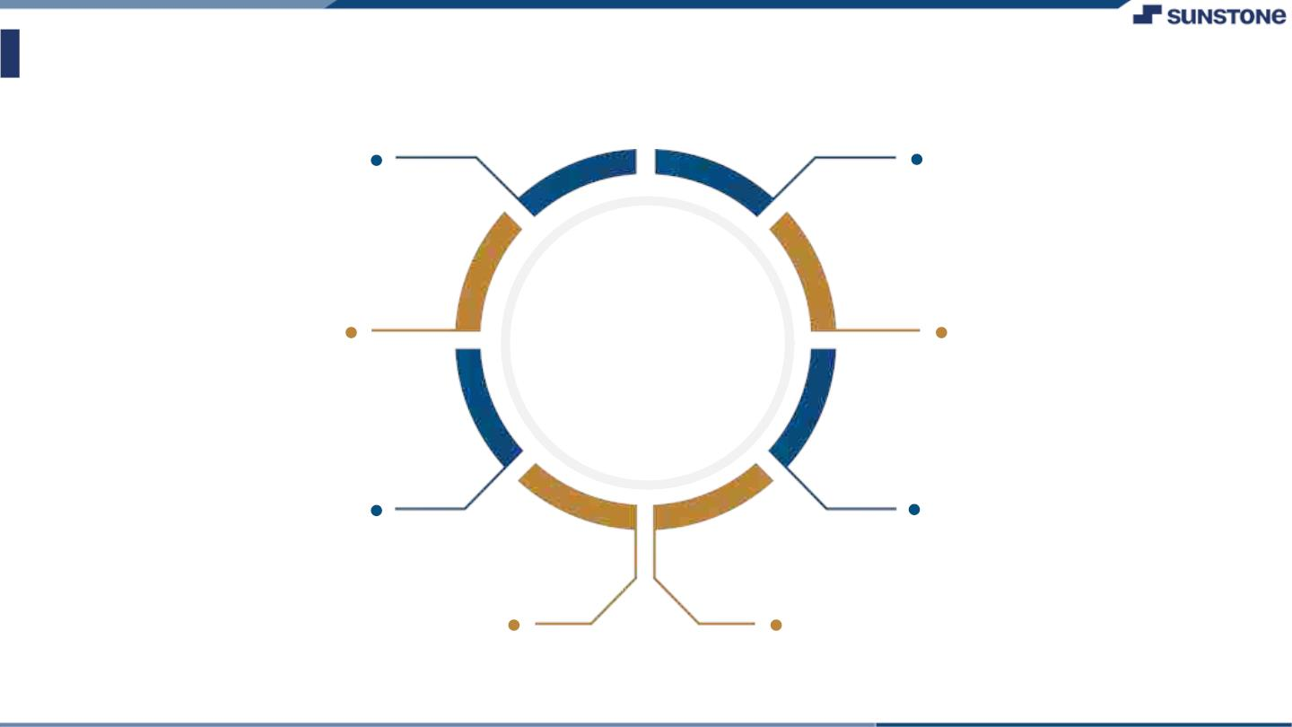
AssessmentꢀParameter
SetupꢀProjectꢀforꢀCalculatorꢀ
project
Setupꢀbasicꢀstructureꢀofꢀtext-
editorꢀproject
Createꢀaꢀmainꢀcomponentꢀwithꢀtheꢀ
outerꢀstructureꢀofꢀcalculator
Check-List
Createꢀmainꢀcomponentꢀwithꢀ
allꢀfeatureꢀbuttons
Createꢀaꢀbuttonꢀcomponentꢀ
withꢀonꢀclickꢀhandler
Createꢀaꢀjsonꢀobjectꢀtoꢀstoreꢀ
dataꢀforꢀtextꢀeditor
Createꢀaꢀ`ꢀevaluateExpresion`ꢀ
functionꢀtoꢀevaluateꢀvalue
Pushꢀbothꢀcodeꢀtoꢀgithub

Slide 6

Submission Github
Github

Slide 7


